Slide 1


Lecture 1: Introduction to Business Intelligence
Ali Chelli
Course: Business Intelligence and Data Warehousing (BID3000)

Slide 2
Outline
Basic Business Intelligence (BI) Concepts
BI Examples
BI Architecture
Business Decisions Types

Slide 3
Basic Business Intelligence Concepts

Slide 4
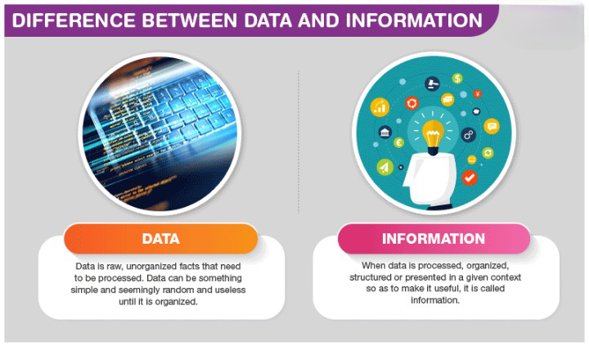
What is Data & Information?

Slide 5
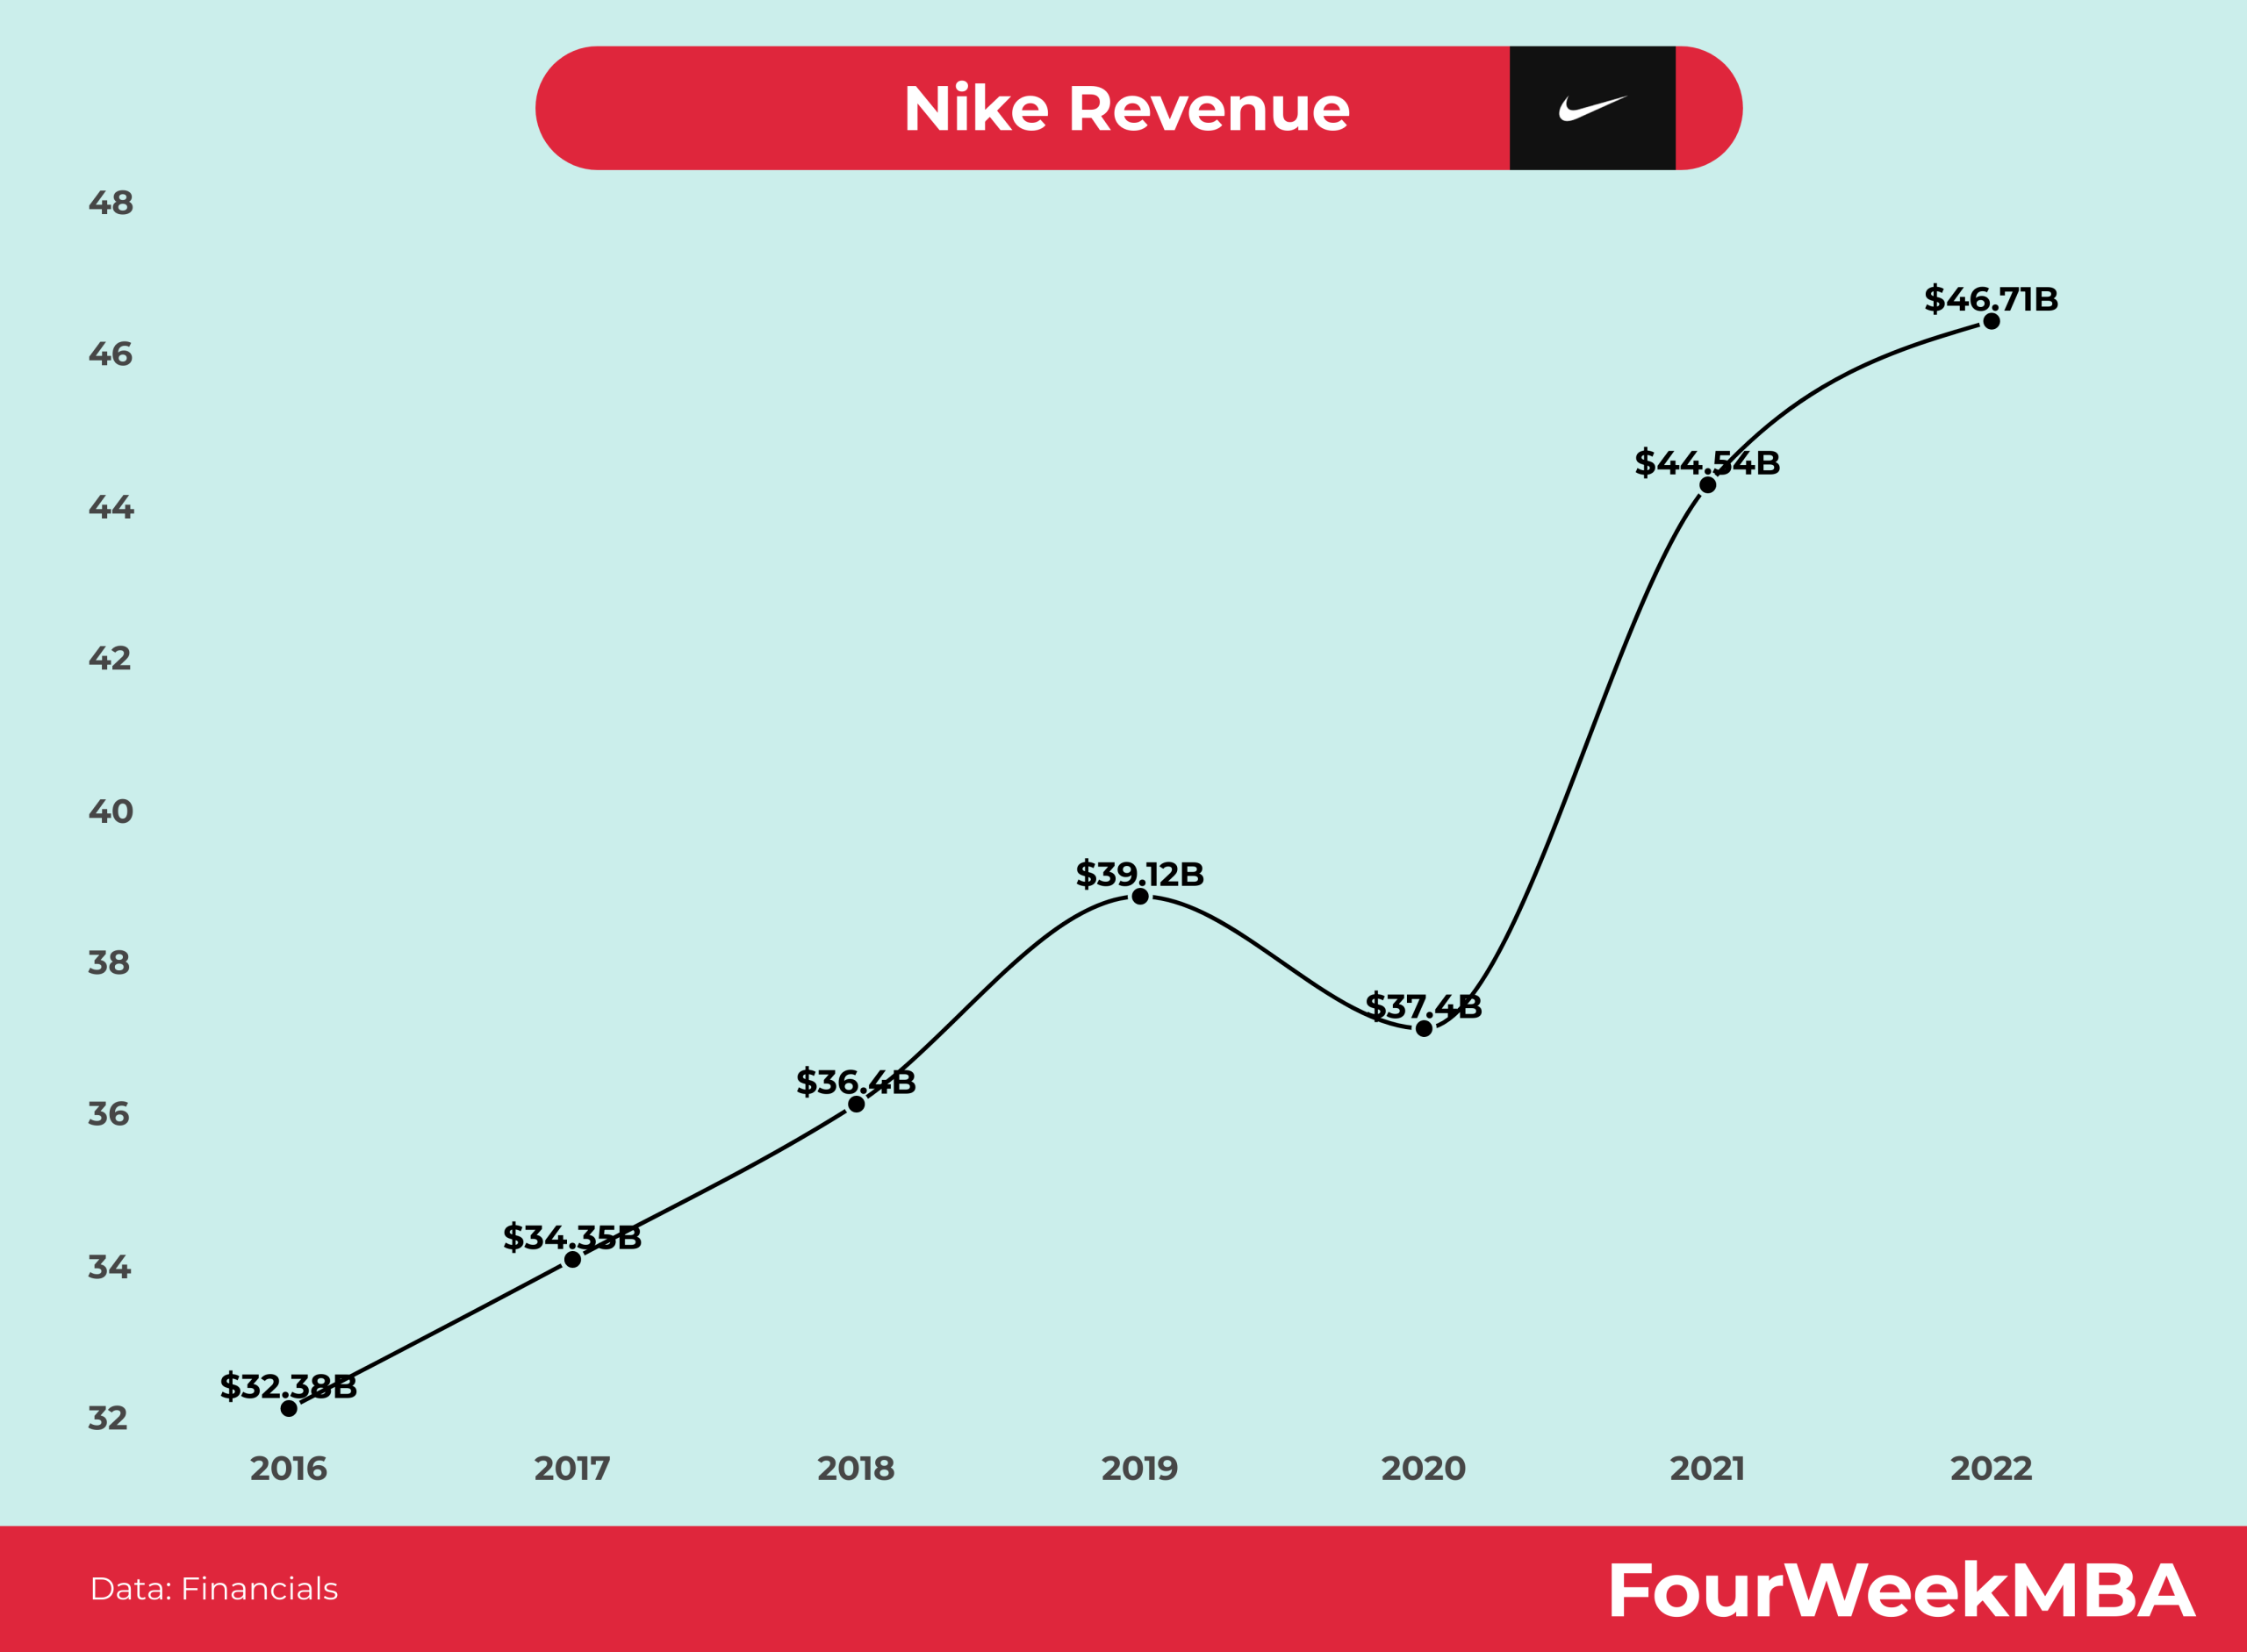
What is Data & Information?
Information
Data (Revenue, Year)
32.38, 2016; 34.35, 2017; 36.4, 2018; 39.12, 2019; 37.4, 2020; 44.54, 2021; 46.71, 2022
Information:
Revenue are growing
From 2016 to 2019 the growth rate is around 7%
The best revenue growth is realized in 2021 with a rate of 19%

Slide 6
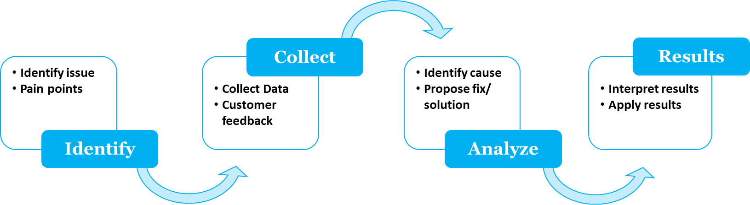
Data Analytics
Process of examining data sets in order to find trends and draw conclusions about the information they contain.
Data analytics technologies and techniques are widely used in commercial industries to enable organizations to make more-informed business decisions.

Slide 7
What is BI?
Business Intelligence (BI) is the set of tools used to collect raw data and transform it into useful insights.
BI allows you to collect data from different sources (multiple databases, excel files, etc.), organize it, and then perform the analytics.
BI provides companies with the most balanced view of the business.
Definition:
BI is a combination of tools, technologies, applications, and practices that help businesses in collecting, integrating, analyzing, and presenting raw data into insightful and actionable business information.

Slide 8
What is BI?
The Data Warehousing Institute defines BI as the processes, technologies, and tools needed to turn data into information, information into knowledge, and knowledge into plans that drives profitable business action.
BI is an umbrella term that encompasses data warehousing, analytical tools, and applications.
These are leveraged to create business intelligence.
The BI process is based on the transformation of the data, to information, then to decisions, and finally to action.
BI is the outcome from this blending process.

Slide 9
How are BI Systems Implemented?
Step 1) Raw Data from corporate databases is extracted. The data could be spread across multiple systems heterogeneous systems.
Step 2) The data is cleaned and transformed into the data warehouse. The table can be linked, and data cubes are formed.
Step 3) Using BI system the user can ask queries, request ad-hoc reports or conduct any other analysis.

Slide 10
What is the Purpose of BI?
The major purpose that Business Intelligence serves for a business is helping the corporate executives (CEO, CTO, business managers and other operational heads) take better data-driven business decisions.
Many companies are using BI for cost-cutting, identifying better business opportunities, and spotting inefficient business processes.

Slide 11
What are the Benefits of Using of BI?
The major benefits of business intelligence are the following:
Accelerating decision-making process
Optimizing internal business processes
Increasing the operational efficiency
Increasing revenues
Gaining competitive advantages
Identifying the market trends
Spotting addressable business problems

Slide 12
BI Examples

Slide 13
Example 1
A hotel manager uses BI analytical applications to gather statistical information regarding average occupancy and room rate.
It helps to find aggregate revenue generated per room.
It also collects statistics on market share and data from customer surveys from each hotel to decides its competitive position in various markets.
By analyzing these trends year by year, month by month and day by day, the manger can choose the best strategy for offering discounts on room rentals.

Slide 14
Example 2
A bank gives branch managers access to BI applications.
It helps branch manager to determine who are the most profitable customers and which customers they should work on.
The use of BI tools frees information technology staff from the task of generating analytical reports for the departments.
The use of BI tools gives department personnel access to a richer data source.

Slide 15
Example 3
In an Online Transaction Processing (OLTP) system information that could be fed into product database could be
add a product line
change a product price
Correspondingly, in a Business Intelligence system the query that would be executed would be how much revenues increased due to
the addition of new product line
and/or the change in products prices

Slide 16
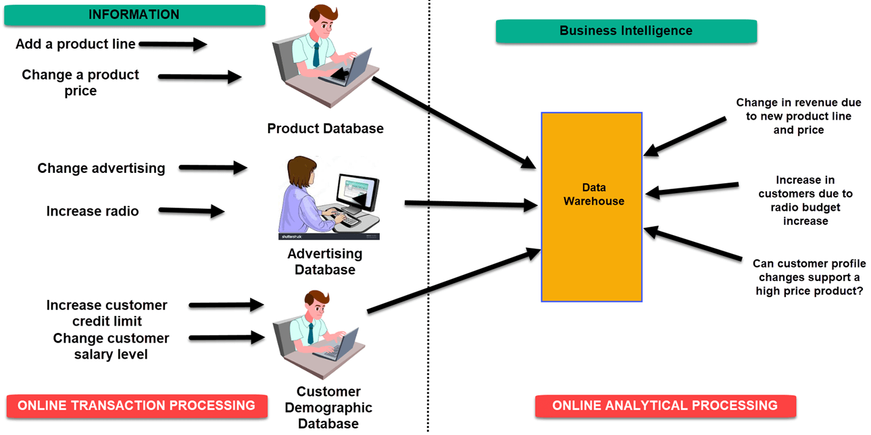
Example 3

Slide 17
Example 3
In an advertising database of OLTP system query that could be executed
Change in advertisement options
Increase of radio budget
Correspondingly, in BI system the query that could be executed would be:
How many new clients were added due to change in radio budget?

Slide 18
Example 3

Slide 19
Example 3
In OLTP system dealing with customer demographic databases, the data that could be fed would be
increase customer credit limit
change in customer salary level
Correspondingly in the OLAP system query that could be executed would be:
Can customer profile changes support higher product price?

Slide 20
Types of BI users
There are four key players who use the Business Intelligence System:
1. The Professional Data Analyst:
The data analyst is a statistician who always needs to drill deep down into data.
BI system helps them to get fresh insights to develop unique business strategies.
2. The IT users:
The IT user also plays a dominant role in maintaining the BI infrastructure.

Slide 21
Types of BI users
3. The head of the company:
CEO can increase the profit of their business by improving operational efficiency in their business.
4. The Business Users:
Business intelligence users can be found across the organization.

Slide 22
BI Architecture

Slide 23
A High-Level BI Architecture
Notes:
A High-Level Architecture of BI.

Slide 24
BI Architecture
BI architecture varies in each enterprise but there are some common components of BI architecture, which are found in all BI solutions.
The component of a BI architecture is driven by the goals and requirements of your enterprise.
Source System
(Enterprise Databases)
Integration Services
(ETL)
Data
Management Services
(Data Warehouse)
Reporting and Analytical Services
(Dashboards/ Scorecards)
Information Delivery and Consumption Services
(Web portals)
Notes:
Above diagram depicts a comprehensive representation of the typical BI architecture.
Multiple Data sources,
data integration services,
data management services,
Reporting and analytical services,
information delivery, and consumption services
form the broad spectrum of the BI architecture.
At the left are the source systems that provide data to the decision support data repository (i.e., data warehouse and marts).
Data integration technology and processes are needed to prepare the data for decision support use.
The mart or warehouse can employ a variety of architectures, technologies, and data models.
On the top, a variety of users can access the data using different tools and applications.
To ensure that BI meets its intended purposes, metadata, data quality, and governance processes must be in place.

Slide 25
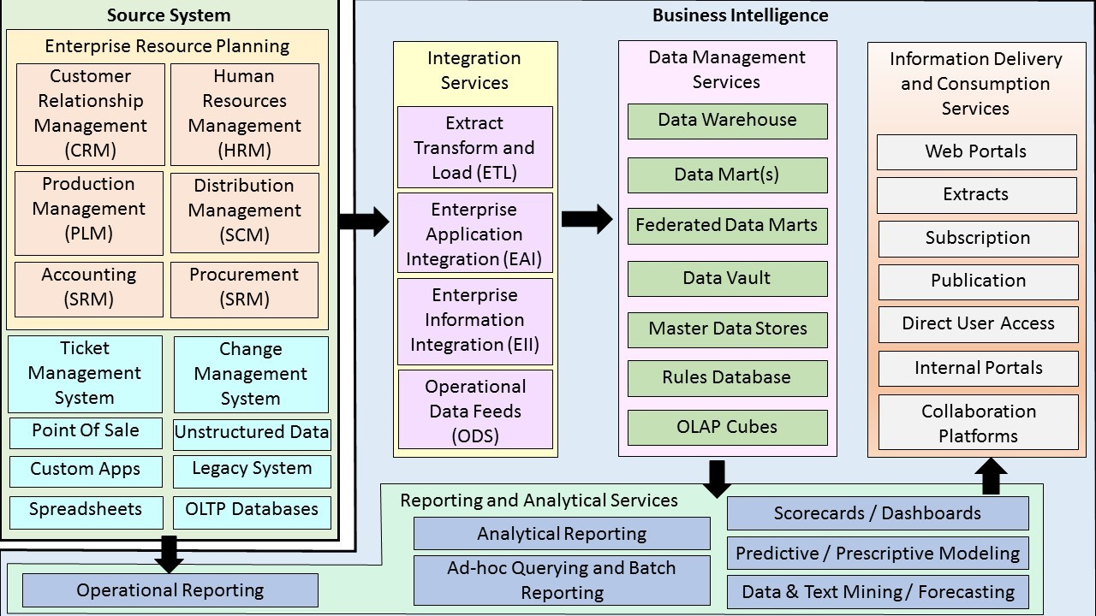
Detailed level BI Architecture
Notes:
Above diagram depicts a comprehensive representation of the typical BI architecture.
Multiple Data sources,
data integration services,
data management services,
Reporting and analytical services,
information delivery, and consumption services
form the broad spectrum of the BI architecture.
At the left are the source systems that provide data to the decision support data repository (i.e., data warehouse and marts).
Data integration technology and processes are needed to prepare the data for decision support use.
The mart or warehouse can employ a variety of architectures, technologies, and data models.
On the top, a variety of users can access the data using different tools and applications.
To ensure that BI meets its intended purposes, metadata, data quality, and governance processes must be in place.

Slide 26
Source Systems
There are many possible data sources – (Enterprise Resource Planning (ERP), Ticket management system, Change management system, point of sale, legacy system, unstructured data, etc.)
The data can be generated by many platforms – IBM, Oracle, Microsoft, Sybase, SAS
The data can have many formats – Relational, Hierarchical, Multi-dimensional, Big data MapReduce Databases, Unstructured text data

Slide 27
BI Services Components
Integration Services (ETL, Operational Data Feeds, Enterprise Application Integration, Enterprise Information Integration)
Data Management Services (data warehouse, data marts, federated data marts, OLAP cubes, etc.)
Reporting and Analytical Services (Analytical Reporting, ad-hoc query and batch reporting, dashboards/scorecards, predictive and prescriptive modeling, data & text mining/forecasting)
Information Delivery and Consumption Services (Web portals, subscription, direct user access, internal portals, etc.)

Slide 28
Business Decision Types

Slide 29
Business Decision Types
Business intelligence systems are used for decision making.
Business decisions can be categorized into three main types:
Strategic Decisions
Tactical Decisions
Operational Decisions

Slide 30
Strategic Decisions
Strategic decisions are major choices of actions and influence whole or a major part of business enterprise.
They contribute directly to the achievement of common goals of the enterprise.
They have long-term implications on the business en­terprise.
They may involve major departures from practices and procedures being followed earlier.
Generally, strategic decision is unstructured and thus, a manager must apply his business judgement, evaluation and intuition into the definition of the problem.

Slide 31
Strategic Decisions
Strategic decisions are based on partial knowledge of the environmen­tal factors which are uncertain and dynamic.
Strategic decisions are taken at the higher level of management.
Example of strategic decision:
Identify new markets
choose store locations.

Slide 32
Tactical Decisions
Tactical decisions relate to the implementation of strategic decisions.
Focus on analyzing short-term initiatives within specific line-of-business domains, such as marketing, sales, purchasing or customer service.
Tactical decisions are directed towards
developing divisional plans,
structuring workflows,
establishing distribution channels,
acquisition of resources such as employees, materials and money.

Slide 33
Tactical Decisions
These decisions are taken at the middle level of management.
Progress is measured against a preset goal, such as a budget or a certain target.
Example of tactical decision:
Choose suppliers,
forecast sales.

Slide 34
Operational Decisions
Operational decisions relate to day-to-day operations of the enterprise.
They have a short-term horizon as they are taken repetitively.
These decisions are based on facts regarding the events and do not require much of business judgement.
Operational decisions are taken at lower levels of management.
Example of operational decision:
Resolve order delays,
schedule employees.

Slide 35
BI Business Value
BI can add value to:
Management Processes:
Planning budgeting, performance monitoring/assessment, process improvement, cost analysis, optimization, etc.
Revenue Generating Processes:
Customer segmentation, campaign management, channel management, sales management, etc.
Resource Consumption Processes:
Product/service development, order management, manufacturing/operations, supply chain, purchasing, etc.
Notes:
The business value of BI lies in its ability to improve the effectiveness of the core business processes that drive business performance.

